Slide 1

Infosys Springboard
Internship 6.0
Milestone - 4
Project Title
Detecting Fake Job Post Using NLP
Team 4
1. Mritunjay Bais (TL) 2. Anil Sonawane
3. Jayesh Sathawane 4. Palam Keerthi
5. Angirekula Lakshmi Sravya

Slide 2
Goal & Context
Objective: Strengthen the NLP pipeline from Milestone-1 by integrating Logistic Regression, Decision Tree, and Random Forest models.
Milestone-2 continues the development of the Fake Job Detection System.
Milestone 3 Convert ML model into working Web Application
Enable real-time Fake/Real job prediction
Store predictions for monitoring and improvement

Slide 3





Core Technologies Used
Flask Backend for API Integration
TF-IDF Vectorizer for Feature Extraction
Logistic Regression Model
NLTK for NLP Cleaning
CSV based Job Log System

Slide 4
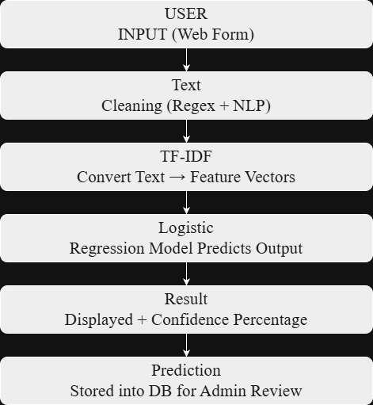
System Workflow
User inputs job text
Text cleaned using NLP
TF-IDF converts text to vectors
Model predicts Fake/Real
Confidence score displayed
Result logged in DB

Slide 5
Web App Integration
Fake Job Detection Using NLP — Web Deployment Phase.
Model integrated with live prediction system.
Complete integration of trained machine-learning model into a live web environment.
Real-time prediction enabled through a fully functional Flask-based interface.
Users can input job descriptions and instantly classify them as Fake or Real.
Confidence scoring system reflects prediction reliability in percentage form.

Slide 6
Backend Implementation
The backend is developed using Python Flask. When a user submits job text:
The API route /predict receives input in JSON format
Text undergoes cleaning such as stopword removal, punctuation removal and lemmatization
Vectorizer (tfidf_ vectorizer . pkl) transforms text into features
Model (fake_job_model.pkl) predicts authenticity
The output is returned along with probability as confidence score
Thus, every prediction passes through preprocessing → vectorization → classification.

Slide 7
Admin Dashboard
Features
Admin has a separate dashboard for monitoring system activity.
Admin Features Developed:
View historical predictions
Check confidence scores and detect patterns
Flag suspicious predictions for inspection
Delete or dismiss flagged entries
Retrain model when performance drops using live train_model.py
Export data to CSV for reporting or research use

Slide 8
Retraining Feature
System allows retraining of the ML model through Admin Panel.
Executes train_model.py automatically without manual handling.
New model file & vectorizer reload instantly without restarting server
Enables the system to learn from new patterns, recent job scams & ongoing inputs.
Makes model more adaptive, stable, and scalable over time.
Ensures higher accuracy with continuous dataset updates.
Suitable for production workflow and long-term deployment environments.

Slide 9
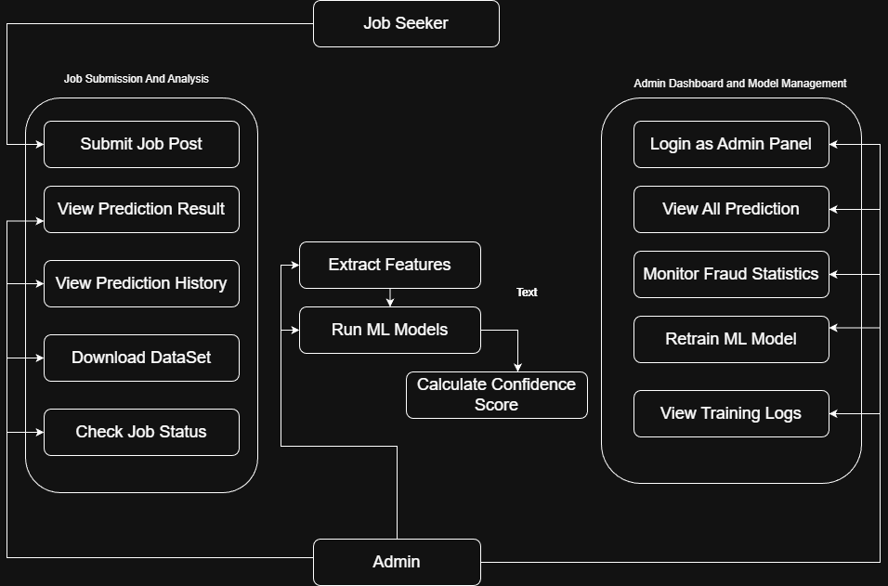
Project Workflow

Slide 10
Outputs & Results
Model Successfully Developed
Confidence Score integration implemented
→ Shows reliability of prediction with probability %
Flagging system & admin controls integrated
→ Suspicious jobs can be reported for review & verification
Retraining pipeline successfully connected
→ Admin can update & enhance model anytime from UI

Slide 11
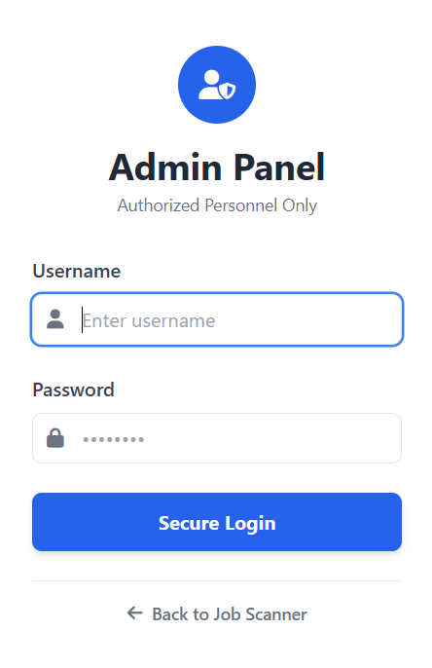
Admin Login

Slide 12
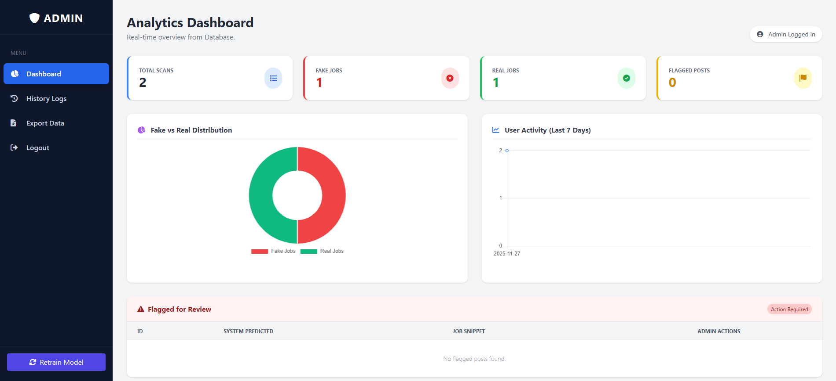
Admin Dashboard

Slide 13
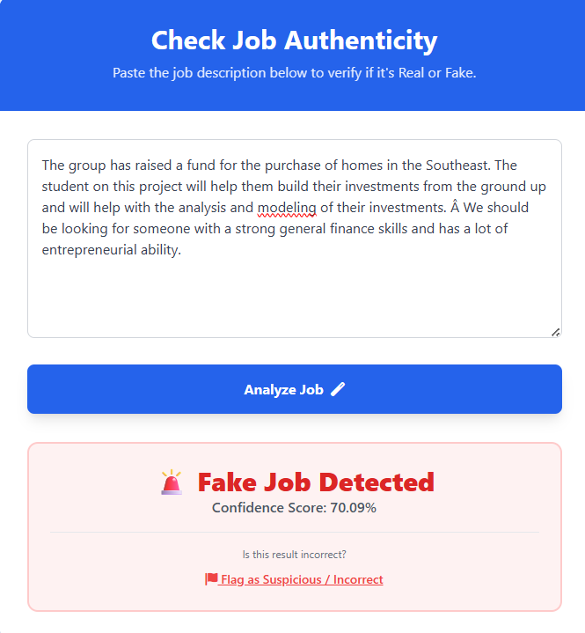
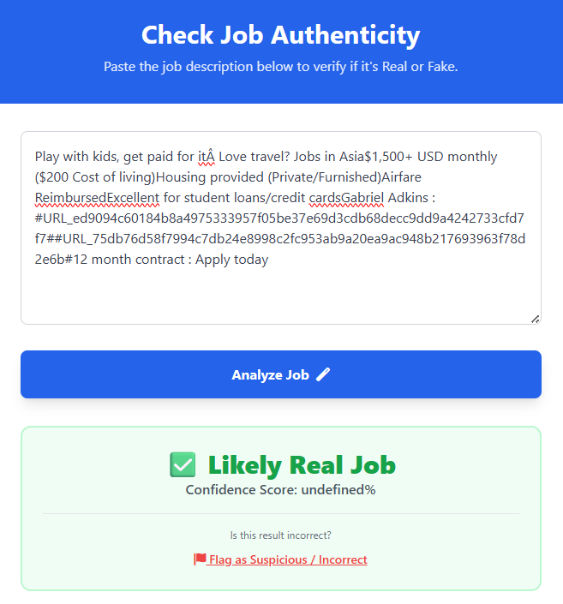
Predection Page

Slide 14
Conclusion
Milestone 4 Evaluation (Week 8):
•Admin can successfully view usage and flagged content.
•Data export and retraining workflows work as expected.
• System is secure with role-based access.

Slide 15
Thank You ☺

